Slide 1
Treating 35 million people with ART – where are we?
Andrew Hill
St Stephens AIDS Trust
Chelsea and Westminster Hospital
London, UK

Slide 2
UNAIDS 90-90-90: HIV Treatment Targets for 2020 with Global Estimates (2014)
Target 1:
90% of HIV+ people diagnosed
Target 2:
90% of diagnosed people on ART
Target 3:
90% of people on ART with HIV RNA suppression
Ref: The Joint United Nations Programme on HIV/AIDS. 90-90-90 An ambitious treatment target to help end the AIDS epidemic. 2014; JC2684 (Numbers as of March 2015) How Aids Changed Everything. Fact Sheet. UNAIDS 2015. MDG 6: 15 YEARS, 15 LESSONS OF HOPE FROM THE AIDS RESPONSE July 2015.
Notes:
In 2014 UNAIDS set 3 ambitious targets to increase global coverage of HIV care by the year 2020
These are:
Target 1 - 90% of all people living with HIV to be diagnosed
Target 2 - 90% of those diagnosed to receive antiretroviral treatment
And Target 3 - 90% of all of those on treatment to achieve viral suppression
This means that in the final category, 73% of all HIV positive people should be achieving viral suppression by 2020.
The numbers here in white show how many people should be in each category, given that nearly 37 million people are estimated to be living with HIV globally.
http://www.unaids.org/sites/default/files/media_asset/JC2702_GARPR2015guidelines_en.pdf

Slide 3
Global Estimates (2014-15) vs the Gap to reach 90-90-90 Targets
Breakpoint 1:
13.4 million
Undiagnosed
Breakpoint 2:
14.9 million
not treated
Breakpoint 3:
15.3 million
Not Virally Supressed
Ref: On ART = March 2015. How Aids Changed Everything. Fact Sheet. UNAIDS 2015. MDG 6: 15 YEARS, 15 LESSONS OF HOPE FROM THE AIDS RESPONSE July 2015. * Average viral suppression% Intention to Treat LMIC rate from a Systematic Review by McMahon J. et al. Viral suppression after 12 months of antiretroviral therapy in low-and middle-income countries: a systematic review." Bulletin of the World Health Organization 91.5 (2013): 377-385.
Notes:
Using the most recent data from UNAIDS, and a systematic review on viral suppression rates by Mcmahon et al, this global cascade estimates where we are currently compared to the targets.
Just over half of all HIV + people know their status and 41% (about 15 million) are on treatment as of March 2015. The numbers in white show the most current estimates for the number of people in each category worldwide.
Where the targets are not yet reached – red arrows illustrate the gaps in the cascade – This is where we are missing the targets and we will define these as breakpoints.
Can these UNAIDS 90-90-90 target be reached? … (Pause)
July 2014 – 13,950,296
http://www.unaids.org/en/resources/presscentre/pressreleaseandstatementarchive/2014/july/20140716prgapreport

Slide 4
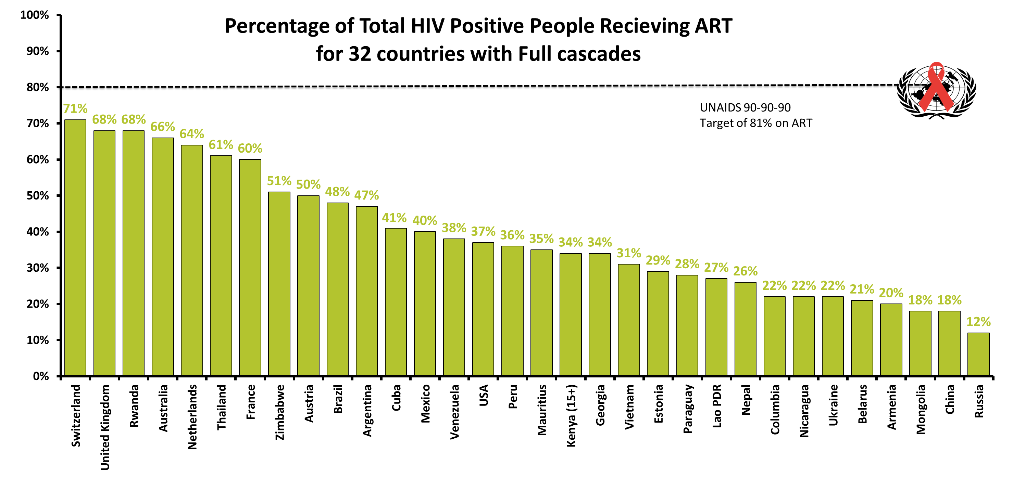
Notes:
This graph shows the percentage of all HIV + people receiving Antiretroviral therapy for all of the countries and one region included in this analyses.
The highest is Switzerland at 71% and the lowest is Russia at 11%.
Providing ART to those diagnosed was the largest breakpoint for Australia, Rwanda, Denmark, Brazil, Cuba, USA, Estonia, Vietnam, Georgia and Kyrgyzstan and Russia

Slide 5
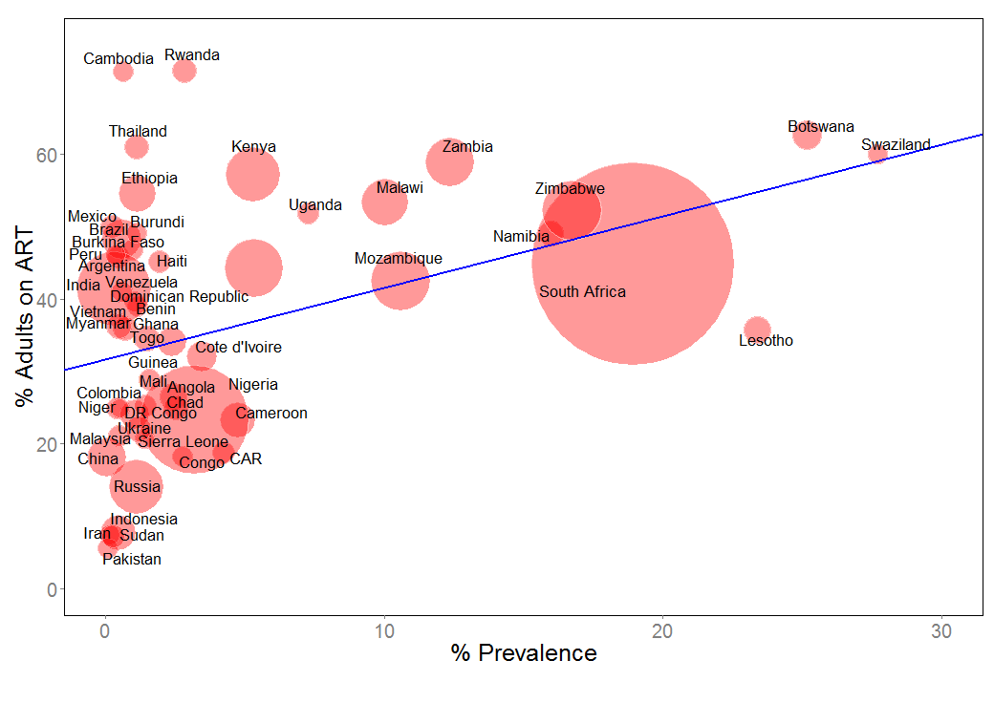
Percentage of adults on ARV treatment versus HIV prevalence

Slide 6
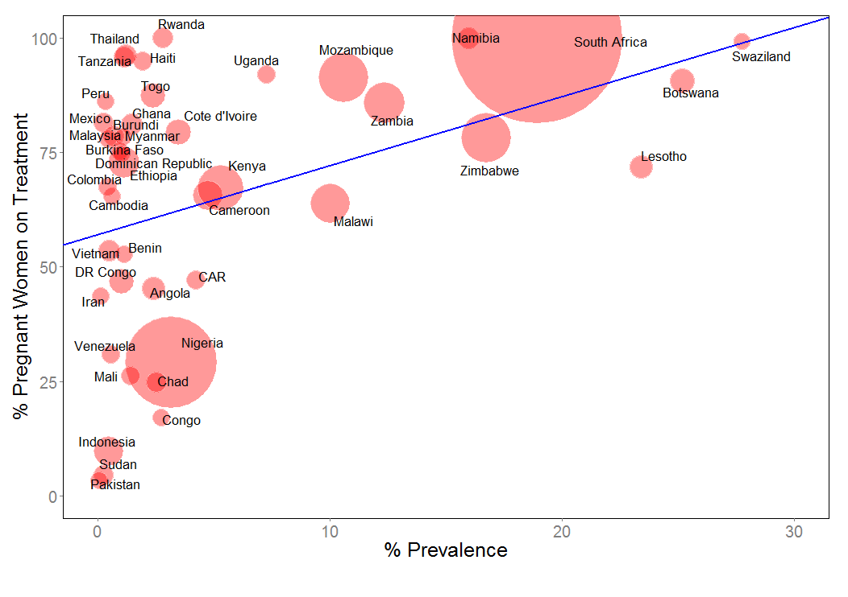
Percentage of pregnant women on ARV treatment vs HIV prevalence

Slide 7
Africa, 1999: mass treatment
for HIV/AIDS is not feasible

Slide 8
A key moment in the history of HIV
“My generics company
can manufacture
HIV antiretrovirals for
a dollar per day”
Dr Yussef Hamied
Cipla,
G8 summit,
2000

Slide 9
Minimum Costs of ARV treatments
GREEN – FULLY GENERIC WORLDWIDE IN 2017
RED – STILL PATENTED TO 2025+ : VOLUNTARY LICENSES
______________________________________________________________
Combination Estimated price / year
______________________________________________________________
TDF/3TC/ATV/r $279
TDF/FTC/ELV/c $184
ABC/3TC/DTG $179
TDF/FTC/EFV600 $144
TDF/3TC/EFV600 $130
TDF/3TC/EFV400 $100
TAF/3TC/DTG $60
DTG/3TC $46
_______________________________________________________

Slide 10
The four key stages for treatment access
1. Voluntary license – allow a generic company to produce the medicine
2. Registration – approval by country health authorities
3. Mass production of high quality medicine by generic companies – pre-qualification by WHO and pre-approval by US FDA
4. Treatment needs to work in real-life settings

Slide 11
Voluntary licenses
Some pharmaceutical companies allow cheap generics to be sold in certain low and middle income countries, with voluntary licenses
China, South America, Russia and Eastern European countries are not included in most of these agreements. As a result, prices in these countries can be unaffordable
Other countries may have voluntary licenses but no registration of the drug – so it is not available

Slide 12
Dolutegravir Voluntary license coverage – GLOBAL
Notes:
Pdf 2010 data

Slide 13
BMS – Atv/r TREATMENT COSTS - AFRICA 2014 - 2015
Other countries:
VLs granted
Median costs (US$)
Senegal
Highest cost*
VL granted
Median cost
US$ 387
*in GPRM database
Togo | 117
Eritrea | 131
Angola | 151
Sierra Leone | 155
Madagascar | 212
Burundi | 219
Nigeria | 219
Rwanda | 219
Ghana | 225
Uganda | 227
Kenya | 228
Zambia | 229
Guinea-Bissau | 229
Chad | 234
Mali | 234
Burkina Faso | 237
Mauritania | 237
Cameroon | 240
Côte d'Ivoire | 243
Guinea | 243
Malawi | 243
Tanzania | 243
Ethiopia | 245
Senegal | 387
Togo
Lowest cost
VL granted
Median cost
US$ 117
Source: GPRM database, April 2016.
Notes:
Pdf 2010 data

Slide 14
JaNSSEN - DRV treatment costs – AFRICA 2014 - 2015
Tunisia
Highest cost
No VL granted / patent enforced
Median cost
US$ 6539
Patent not enforced
Median costs (US$)
South Africa | 379
Uganda | 755
Togo | 817
Mauritius | 928
No VL / Patent enforced
Median costs (US$)
Morocco | 5010
Egypt | 5216
Tunisia | 6539
South Africa
Lowest cost
Patent not enforced
Median cost
US$ 379
Source: GPRM database, April 2016.
Notes:
Pdf 2010 data

Slide 15
ABBVIE – LPV/r treatment costs – AFRICA 2014 - 2015
Other countries:
VL granted - Generic
Median costs (US$)
VL granted –
Originator
Median costs (US$)
CAR | 214
Eritrea | 226
Equatorial Guinea | 226
Kenya | 227
Togo | 231
Guinea | 232
DRC | 240
Rwanda | 249
Congo | 253
Ghana | 265
Sierra Leone | 333
Senegal | 508
Chad | 217
Djibouti | 217
Zambia | 219
Zimbabwe | 219
Mali | 222
Sudan | 223
Angola | 223
Sao Tome | 223
Egypt | 225
Gabon | 225
Somalia | 225
Comoros | 227
Nigeria | 228
Cameroon | 230
Gambia | 230
G-Bissau | 230
Uganda | 230
Tanzania | 230
South Sudan | 230
Burundi | 230
Côte d'Ivoire | 230
Mauritania | 230
Mozambique | 230
South Africa | 244
Lesotho | 255
Mauritius | 258
Senegal
Highest cost
VL granted
Median cost
US$ 508
CAR
Lowest cost
VL granted
Median cost
US$ 214
Source: GPRM database, April 2016.
Notes:
Pdf 2010 data

Slide 16
Minimum Costs of ARV treatments
GREEN – FULLY GENERIC WORLDWIDE IN 2017
RED – STILL PATENTED TO 2025+ : VOLUNTARY LICENSES
______________________________________________________________
Combination Estimated price / year
______________________________________________________________
TDF/3TC/EFV600 $130
TDF/3TC/EFV400 $100
TAF/3TC/DTG $60
_______________________________________________________

Slide 17
New ARVs Could Represent Over USD 3 Billion in Cost Savings Through 2025
Vineet Prabhu, Cebele Wong, Sarah Jenkins, Saman Nizami, Kelly Catlin, Paul Domanico
Clinton Health Access Initiative (CHAI)
No financial disclosures to report

Slide 18
Estimated Savings from New ARVs 2019-2025* (USD millions)
Annual Savings ($M)
*Expect minimal to negative savings for first 1-3 years of DTG launch (2017-2019)

Slide 19
Full roll-out of DTG and TAF?
Efficacy and safety for:
- Pregnant women
- During rifampicin-based treatment for TB

Slide 20
Dolutegravir in pregnancy: Background
No fetal toxicity or teratogenicity in animal studies described in manufacturer’s submission for regulatory approval
Schalkwijk et al 2015 showed high placental transfer of DTG relative to other ARVs in an ex vivo study
A case study by Pain et al 2015 described “unexpected placental transfer of DTG with fetal accumulation and then slow neonatal clearance”
European Medicines Agency. Tivicay, INN-dolutegravir. Annex I: Summary of Product Characteristics. http://www.ema.europa.eu/docs/en_GB/document_library/EPAR_-_Product_Information/human/002753/WC500160680.pdf
Schalkwijk S, Greupink R, Colbers AP, Wouterse AC, Verweij VGM, van Drongelen J, et al. Placental transfer of the HIV integrase inhibitor dolutegravir in an ex vivo human cotyledon perfusion model. J Antimicrob Chemother. 2015 Nov 3 pii: dkv358. [Epub ahead of print] Available from: http://www.jac.oxfordjournals.org/lookup/doi/10.1093/jac/dkv358
Pain JB, Lê MP, Caseris M, Amiel C, Lassel L, Charpentier C, et al. Pharmacokinetics of Dolutegravir in a Premature Neonate after HIV Treatment Intensification during Pregnancy: FIG 1. Antimicrob Agents Chemother [Internet]. 2015 Jun;59(6):3660–2. Available from: http://aac.asm.org/lookup/doi/10.1128/AAC.00173-15

Slide 21
Clinical trials and CU outcomes
Outcome | DTG | EFV | RAL | DRV/r
Live infant, congenital anomaly | 1 | 0 | 0 | 0
Live infant, no apparent congenital anomaly | 18 (inc 1x twins) | 3 | 2 | 1
Elective termination, no apparent congenital anomaly | 9 | 1 | 4 | 0
Spontaneous abortion, no apparent congenital anomaly | 13 | 2 | 1 | 1
Ectopic pregnancy | 3 | 1 | 0 | 0
Pregnancy ongoing or unknown | 0 | 0 | 0 | 0
TOTAL | 38 | 7 | 7 | 2

Slide 22
Post-marketing pregnancy outcomes: 74 reported from spontaneous sources to 16 January 2016
Outcome | DTG
Live infant, no apparent congenital anomaly | 18
Live infant, congenital anomaly | 2
Spontaneous abortion, no apparent congenital anomaly | 4
Spontaneous abortion, congenital anomaly * | 1
Stillbirth, no apparent congenital anomaly | 1
Pregnancy ongoing, LTFU or unknown | 39
TOTAL | 74
*Patient became pregnant while taking DTG + TDF/FTC. DTG d/c’d and changed to RAL. Prenatal USS (unspecified date) showed fetal dystrophy. Gestational week 7 patient experienced spontaneous abortion.

Slide 23
DTG – study program for pregnant women
1. ING200336: DTG Pregnancy study (n=25)
2. Dolphin-1 study (Uganda, n=60)
3. PANNA study – includes DTG (n=14)
4. IMPAACT 1026s study – includes DTG arms
5. Antiretroviral pregnancy registry (n=28 so far)

Slide 24
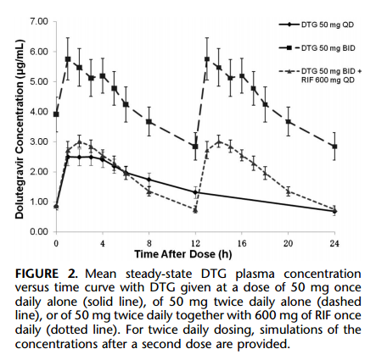
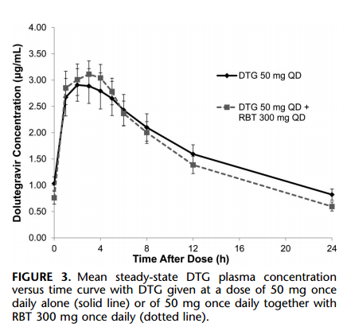
DTG dosage should be doubled to 50 mg twice daily in presence of rifampicin but not rifabutin
Charts from Dooley KE, Sayre P, Borland J, Purdy E, Chen S, Song I, Peppercorn A, Everts S, Piscitelli S, and Flexner C. Safety, Tolerability, and Pharmacokinetics of the HIV Integrase Inhibitor Dolutegravir Given Twice Daily With Rifampin or Once Daily With Rifabutin: Results of a Phase 1 Study Among Healthy Subjects. J Acquir Immune Defic Syndr 2013; 62:21-27.

Slide 25
Open-label Study of Dolutegravir (DTG) or Efavirenz (EFV) for Human Immunodeficiency Virus (HIV) - Tuberculosis (TB) Co-infection (currently recruiting)
Arms
DTG 50 mg plus dual NRTI during RIF-containing TB treatment and for 2 weeks following discontinuation of TB treatment, then once-daily DTG 50 mg with the same NRTI through Week 52 | Once-daily EFV 600 mg plus dual NRTI through Week 52 along with TB treatment including isoniazid, RIF, pyrazinamide and ethambutol standard doses
Estimated enrolment: 125 participants (DTG arm: 75 / EFV arm: 50)
Study start date: January 2015 (Run by ViiV)
Estimated study completion date: June 2019
Table adapted from Viiv Healthcare. Open-label Study of Dolutegravir (DTG) or Efavirenz (EFV) for Human Immunodeficiency Virus (HIV) - Tuberculosis (TB) Co-infection. [Internet]. Oct 2015. Available from: https://clinicaltrials.gov/show/NCT02178592

Slide 26
TAF PK in pregnancy - implications
Intracellular concentration of Tenofovir-DP is 4-5 times higher for TAF compared to TDF
Does this expose the fetus to a higher risk of birth abnormalities?
Does this lower the risk of vertical transmission?

Slide 27
Review of all published TAF trial results for pregnant women, on PubMed
Study | Drugs included | Number of female participants | Obstetric adverse events
Markowitz 2014 | TAF vs TDF | 3 | None reported
Sax 2014 | E/C/F/TAF vs E/C/F/TDF | 5-6 | None reported
Agarwal 2015 | TAF | 17 | None reported
Sax 2015 | E/C/F/TAF vs E/C/F/TDF | 260 | 5 patients in TDF arm discontinued trial due to pregnancy
Ruane 2013 | TAF | 1 | None reported
Mills 2015 | E/C/F/TAF vs E/C/F/TDF | 153 | None reported

Slide 28
TAF contraindicated with rifampicin
According to Gilead’s co-administration warnings, tenofovir alafenamide (TAF) is contraindicated with rifampicin.¹
Interactions predicted with PGP and other transporters
No Clinical experience in trials, but is TAF over-dosed anyway?
Plasma concentrations of elvitegravir and cobicistat can be significantly decreased when co-administered with rifampicin due to its induction of CYP450.¹
¹Gilead Sciences. Highlights of prescribing information. [Internet] 2015. Available from: https://www.gilead.com/~/media/files/pdfs/medicines/hiv/genvoya/genvoya_pi.pdf?la=en

Slide 29
Phase 3 trials - TAF versus TDF Week 48 results
_______________________________________________________
Treatment arm TAF/FTC/ELV/c TDF/FTC/ELV/c
_______________________________________________________
Any adverse event 93% 95%
Drug-related AE 42% 46%
Grade 3 or 4 AE 12% 12%
Discontinuation for AE 1% 2%
Deaths 0.2% 0.3%
______________________________________________________
EACS Conference 2015

Slide 30
PK trial needed, to evaluate TAF/FTC with rifampicin
Inclusion: 25 healthy volunteers
Design: Comparison of plasma and intracellular concentrations of
tenofovir-DP and FTV-DP levels at each phase
Day 1-28
Day 29-42
Day 43-70
TAF/FTC
TAF/FTC
+
Rifampicin
TDF/FTC
PK
PK
PK
COMPARISON WITH TDF 300 MG IS KEY
Trial is in planning stage

Slide 31
Full roll-out of DTG and TAF?
Is it easier to give everyone a single pill with TDF/3TC/EFV?
Is it too complex to double the dose of DTG with rifampicin?
Is the safety benefit of TAF worth the complications of rifampicin interactions?
How much safety data do we need in pregnancy?

Slide 32
Could we eliminate Hepatitis B and C worldwide by producing treatments cheaply?

