Slide 1
UNITAID-CHAI Optimal ARV Community Advisory Board (CAB): Inception Meeting
Dakar, Senegal| April 11-12, 2017

Slide 2
Welcome to CAB members!
Ibrahima Ba
RNP+
Proscovia Namakula
Stephen Watiti
ICW (East Africa)
Francine Nganale
ICW+ Cameroon
Salim Kibet
Islamic Men’s Network
Jacqueline Wambui
National Empowerment Network of People Living with HIV/AIDS in Kenya (NEPHAK)
Obatunde Oladap
Olubukola Ayinde
Positive Life Association of Nigeria (PLAN)
Imelda Mahaka
Pangaea Zimbabwe
Tapiwanashe Kujinga
Pan-African Treatment Access Movement
Sorn Sotheariddh
National Positive Network in Cambodia
Luckyboy Mkhondwane
Treatment Action Campaign (TAC)
George Kampango
Clara Banga
Malawi Network of PLHIV
Kenly Sikwese – AfroCAB
Memory Sachikonye, Polly Clayden - iBase
Danielle Ferris- UNITAID
Carolyn Amole, Herb Harwell, Caroline Middlecote, Benvy Caldwell – CHAI

Slide 3
Welcome to our Sengalese colleagues!

Slide 4
Agenda Overview: Tuesday, April 11
Time | Topic | Presenter
9:00 – 9:45 | Welcome and CAB Overview | Kenly Sikwese (AfroCAB)
9:45 – 10:45 | Introduction and Setting the Scene: Country Context | CAB Country Members
10:45 – 11.10 | Break
11:10 – 11:30 | Background on the Optimal ARV grant and goals of the CAB | Carolyn Amole and Caroline Middlecote (CHAI)
11:30 – 13:00 | Background on Optimal ARV products Product overviews and discussion Discussion on community engagement with clinicans and opportunity for joint advocacy Review of clinical trials | Herb (CHAI), Kenly (AfroCAB), Polly (i-Base)
13:00 – 14:00 | Lunch
14:00 – 15:30 | Role playing! Engaging with community MoH and partners on new product introduction | Luckyboy (TAC) and Polly (i-Base)
 | End of meeting - time for side meetings

Slide 5
Agenda Overview: Wednesday, April 12
Time | Topic | Presenter
9:00 – 11:30 | Drafting country plans: Morning working session (tea break to be taken at leisure when served) Country representatives will work in pairs by country Goal: Develop plans on who to partner with, activities to conduct and potential barriers Feedback on plans to the group and discussion | Kenly to facilitate
11:30 – 12:00 | Working with CHAI country teams: developing a framework for engagement and partnership | Stella and Caroline (CHAI)
12:00 – 13:00 | Break for lunch
13:00 – 13:45 | AfroCAB App! | Kenly
13:45 – 14:30 | Meeting wrap-up and next steps | Kenly and Polly
End of meeting - time for side meetings

Slide 6
Agenda Overview: Tuesday, April 11
Time | Topic | Presenter
9:00 – 9:45 | Welcome and CAB Overview | Kenly Sikwese (AfroCAB)
9:45 – 10:45 | Introduction and Setting the Scene: Country Context | CAB Country Members
10:45 – 11.10 | Break
11:10 – 11:30 | Background on the Optimal ARV grant and goals of the CAB | Carolyn Amole and Caroline Middlecote (CHAI)
11:30 – 13:00 | Background on Optimal ARV products Product overviews and discussion Discussion on community engagement with clinicans and opportunity for joint advocacy Review of clinical trials | Herb (CHAI), Kenly (AfroCAB), Polly (i-Base)
13:00 – 14:00 | Lunch
14:00 – 15:30 | Role playing! Engaging with community MoH and partners on new product introduction | Luckyboy (TAC) and Polly (i-Base)
 | End of meeting - time for side meetings

Slide 7
Introductions and Scene Setting: Country Context
Ibrahima Ba
RNP+
Proscovia Namakula
Stephen Watiti
ICW (East Africa)
Francine Nganale
ICW+ Cameroon
Mustafa Salim Kibet
Islamic Men’s Network
Jacqueline Wambui
National Empowerment Network of People Living with HIV/AIDS in Kenya (NEPHAK)
Obatunde Oladapo
Olubukola Ayinde
Positive Life Association of Nigeria (PLAN)
Imelda Mahaka
Pangaea Zimbabwe
Tapiwanashe Kujinga
Pan-African Treatment Access Movement
Sorn Sotheariddh
CPN+
Luckyboy Mkhondwane
Treatment Action Campaign (TAC)
George Kampango
Clara Banya
Malawi Network of PLHIV
Kenly Sikwese – AfroCAB
Memory Sachikonye, Polly Clayden - iBase
Danielle Ferris- UNITAID
Carolyn Amole, Herb Harwell, Caroline Middlecote, Benvy Caldwell – CHAI

Slide 8
Agenda Overview: Tuesday, April 11
Time | Topic | Presenter
9:00 – 9:45 | Welcome and CAB Overview | Kenly Sikwese (AfroCAB)
9:45 – 10:45 | Introduction and Setting the Scene: Country Context | CAB Country Members
10:45 – 11.10 | Break
11:10 – 11:30 | Background on the Optimal ARV grant and goals of the CAB | Carolyn Amole and Caroline Middlecote (CHAI)
11:30 – 13:00 | Background on Optimal ARV products Product overviews and discussion Discussion on community engagement with clinicans and opportunity for joint advocacy Review of clinical trials | Herb (CHAI), Kenly (AfroCAB), Polly (i-Base)
13:00 – 14:00 | Lunch
14:00 – 15:30 | Role playing! Engaging with community MoH and partners on new product introduction | Luckyboy (TAC) and Polly (i-Base)
 | End of meeting - time for side meetings

Slide 9
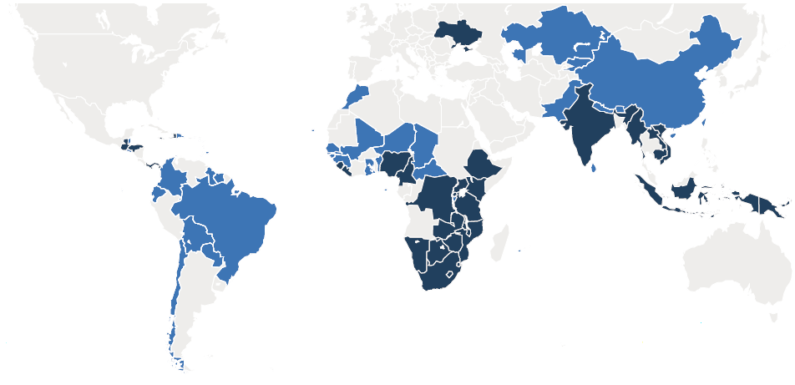
CHAI Background
Founded in 2002 by President Clinton and Ira Magaziner to fight the AIDS pandemic
Global Operations based in Boston, Massachusetts
More than 1300 staff members worldwide (approximately 50% key local nationals)
33 program countries (dark blue)
More than 70 procurement consortium countries (lighter blue)
Notes:
-Explain program and purchasing consortium countries

Slide 10
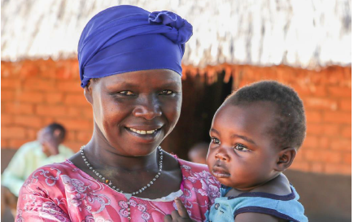
CHAI Background: CHAI HIV Access Program Mission Statement
Our mission is to scale access to effective
HIV prevention and treatment services
for all who need them.
We do this by ensuring rapid access to the best products at affordable and sustainable prices, and by increasing efficiency in the HIV prevention and treatment cascades.
Notes:
CHAI was founded in 2002 by US President Bill Clinton and Ira Magaziner to fight the AIDS pandemic, and this work is still central to the CHAI mission.

Slide 11
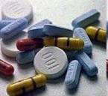
CHAI’s strategy is based on coordinated engagement with both the supply and demand sides of the ARV market
SUPPLY
DEMAND
Volumes
Demand-side
Supply-side
The demand side needs:
ARVs that meet the needs of resource-limited settings in terms of quality, formulation, and price, to enable patient scale-up on high-quality ARVs
The supply side needs:
A reliable, transparent, marketplace for ARVs that provide ongoing growth, to ensure a sustainable supplier base
Insight
Notes:
When we think about new product introduction, we think about interventions to take and levers that we need to pull on both sides of this market.

Slide 12
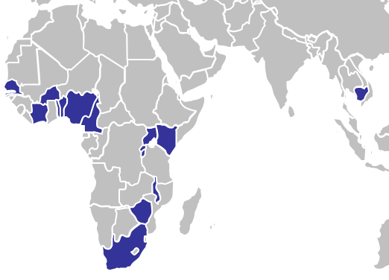
The UNITAID-CHAI Optimal ARV project aims to generate demand for target ARVs in high-burden focal countries, driving rapid uptake and lowering global costs
Optimal ARV Project Focus Areas:
Engage with suppliers to accelerate time to market and optimal pricing
Identify opportunities for cost reduction through process chemistry improvements in a lab
Engage with MoH, civil society, and other stakeholders to support adoption and roll-out of optimal products, and drive uptake in focal countries
IMPACT:
COST SAVINGS THROUGH 2023
GLOBAL COST SAVINGS THROUGH 2024
$1.6B
and improved clinical outcomes for patients
FOCAL COUNTRIES
TARGET PRODUCTS
Adults | Pediatrics
EFV 400 | LPV/r Pellet (uptake)
DRV/r | DRV/r
DTG | DTG
TAF | ABC/3TC/EFV (uptake)
 | Pipeline FDC (TAF/XTC/DTG, TBD)
Cambodia, Kenya, Malawi, Nigeria, South Africa, Uganda, Zimbabwe
and a peds focus in Francophone West Africa

Slide 13
A coordinated approach with global and in-country partners will be critical to the success of this project
WHO
Global Fund
PEPFAR-OGAC, USAID/PSM
ARV Procurement Working Group (APWG)
Ministries of Health
Innovator and Generic Suppliers
Ministries of Health
Community
Regulatory Agencies
Innovator and Generic Suppliers
MPP
DNDi
Project OPTIMIZE and all its implementing partners – including ICAP and Wits
In-country implementing partners
Notes:
The community engagement piece is particularly important to this grant. While CHAI has been on the forefront of a lot of work in the HIV treatment access space, we have not included community engagement specifically in our grants in the past. Our approach is to partner directly with governments. In some countries, our offices are still located in Ministry of Health office. But in thinking through our approach on this grant, we determined that increasing our collaboration with community was not only the right thing to do, but also absolutely essential to the success of the project. Working with community and working with governments are not mutually exclusive.

Slide 14
Question: Why is Community Engagement so Important to Optimal Treatment Access?

Slide 15
Answers: Why is Community Engagement so Important to Optimal Treatment Access?
Community can play a pivotal role in accelerating access to new, optimal products through both advocacy and supporting roll-out
“Our biggest mistake in product roll-out in the past has been not involving the community” – Ministry of Health Official
Community participation can help ensure the communication and approach is appropriate for target groups
The CAB can represent the community voice across countries in providing input and guidance on pressing issues in treatment access
What is missing?
Community engagement is critical to long-term sustainability
Notes:
On sustainability: NGOs will come and go but community will stay – CHAI wants to work itself out of jobs

Slide 16
CHAI’s work in countries consists of a holistic set of interventions to accelerate introduction of optimal new products for PLHIV
PRODUCT REGISTRATION
E.g., Support for product waiver process to facilitate early access to DTG in Uganda and Nigeria
COMMUNITY ENGAGEMENT
E.g.: Establishment of a Community Advisory Board and collaboration on demand generation activities
FACILITY-LEVEL PLANNING
E.g.: In Cameroon, supporting LPV/r pellet rollout, including trainings and monitoring for facilities
APPROACH: CHAI provides end-to-end support in countries to facilitate new product introduction.
Adoption
Product Registration
Procurement
KOL/Partner Engagement
Central-Level Uptake Planning
Facility-level Uptake Planning
Monitoring Uptake
GUIDELINE ADOPTION
E.g.: Developed WHO guideline costing tool and costing analysis in Nigeria, Uganda, Kenya, Cambodia, South Africa, Zimbabwe
TENDERING AND FORECASTING
E.g.: RSA Tender support
and development of database to monitor supplier performance
PRODUCT TRANSITION PLANNING
E.g.: Development and implementation of early adopter research for LPV/r pellets in Zimbabwe
PRODUCT ROLLOUT MONITORING
E.g.: ABC/3TC 120/60, product transition, scale-up, and supply monitoring through APWG

Slide 17
Dolutegravir (DTG) is a new and highly optimal ARV. CHAI is supporting DTG adoption and introduction across all focal countries, as well as limited procurement for three early adopter countries – Kenya, Uganda, Nigeria
Tunisia
Morocco
Algeria
India
Myanmar
Western Sahara
Libya
Egypt
Vietnam
Mauritania
Mali
Cambodia
Senegal
Niger
Sudan
Eritrea
Gambia
Chad
Djibouti
PNG
Guinea Bissau
Guinea
Burkina
Central African
Republic
Sierra Leone
Ivory
Coast
Nigeria
Ethiopia
Somalia
Liberia
Cameroon
Uganda
Ghana
Benin
Equatorial Guinea
DRC
Kenya
Togo
Gabon
Rwanda
Congo
Burundi
Tanzania
DTG/TLD Guideline Adoption
 | No data collected or non-focal country
 | Guideline process not started or underway in focal country
 | included in guidelines or draft in focal country
Angola
Malawi
Mozambique
Zambia
Namibia
Zimbabwe
Botswana
Madagascar
Swaziland
Lesotho
South Africa

Slide 18
Several countries have initiated early adoption and procurement of DTG that will lead to national scale-up when FDCs become available
DTG Product Adoption
CHAI has supported 6 countries to include DTG in final or draft guidelines, in addition to providing intensive support on TLD for the tender process in South Africa
Three countries are part of the CHAI-UNITAID procurement detailed below
In addition, Cambodia hopes to procure DTG singles in 2017 through their national procurement system, to inform national scale-up with FDCs in the future
CHAI-UNITAID Catalytic Procurement of DTG for Early Adopter Countries
Three countries will roll out DTG and conduct enhanced implementation monitoring to determine key requirements for national roll-out, and provide a platform for TLD FDC introduction
Enhanced Implementation Monitoring: Focus will include enhanced monitoring on toxicity; patient acceptability and preference (e.g. for those with EFV-intolerance); prescriber and dispenser knowledge gaps; training needs; pregnancy monitoring; and viral suppression
Kenya
Nigeria
Uganda
12 month supply for
12 month supply for
12 month supply for
20,000 patients
6,500 patients
6,500 patients

Slide 19
Role of the CAB in the Optimal ARV Project
1
2
Represent the interests of the global HIV community within the project
Support appropriate community-led demand generation activities for optimal ARVs
Ensuring the program meets local needs and contributes to improved treatment outcomes for people living with HIV
Participating in the CAB and staying abreast of project progress through semi-annual CAB meetings
Monitoring progress and ensuring that program outcomes are shared with the global HIV community.
Supporting communication of information related to the project objectives and progress to the broader global community
Serving as the voice of the community by participating in the process of defining appropriate demand generation activities and raising issues that could affect successful implementation of the project
Provide the project team with ongoing recommendations on product adoption and roll-out strategies

Slide 20
Optimal ARV CAB Practicalities
Primary and alternate members: Primary members requested to attend CAB meetings, with alternate members attending as needed
1-2 in-person meetings per year/rotating locations: Objective is to have 1-2 in-person meetings per year, and ongoing communication amongst the group
Linkage between CAB members, other civil society organizations and CHAI country teams in countries: Engagement with CHAI country teams to be discussed tomorrow; CAB members requested to support communication of project and activities at national level
Implementation of demand generation activities: Budgets for community activities at national level to be coordinated between CAB, CHAI country teams, and other community organizations

Slide 21
The CAB is supported by a UNITAID grant
CHAI’s work on accelerating access to optimal ARVs
is made possible by the generous support and partnership of UNITAID

Slide 22
UNITAID's mission & new strategy
Mission
Maximize the effectiveness of the global health response by catalyzing access to better health products
Strategic Objectives
Innovation, Access and Scalability
Notes:
History
Since it's inception in 2006, UNITAID has worked through market based interventions to improve access to essential health products in the 3 diseases for the people who needed them the most.
Through advanced purchase committements and bulk procurement – UNITAID was able to fill huge gaps in paediatric and 2nd line treatment for those living with HIV
UNITAID also supported (and still supports) initiatives to:
Overcome intellectual property barriers to access via MPP
Improve quality assurance for medicines/diagnostics including prequalification.
Now with the evolving global health landscape, UNITAID is engaging more targeted interventions - highlighted in the new 2017 – 2021 Strategy

Slide 23
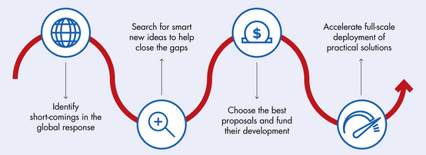
HOW UNITAID OPERATES NOW
UNITAID collaborates with global health partners and governments to:
Notes:
Where do Unitaid's interventions start and end?
Start - Unitaid's interventions usually start when products are commercially available or close to product launch – Unitaid for example supports late stage development.
End - Unitaid's interventions end with preparing the transition to scale - implementation at scale is funded by Unitaid's partners.

Slide 24
What are concrete interventions?
Support evidence-gathering for new health products
Ensure markets are prepared for the priority combinations (manufacturer side & demand side)
Coordination with partners, including communities and countries, to support rapid introduction and scale-up in countries in a timely manner

Slide 25
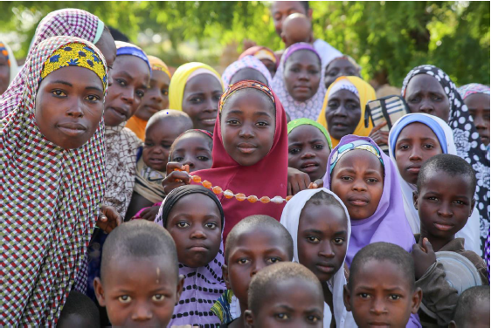
Thank you!

